Slide 1


Graphical Abstract
Sara Hocevar
Oikos Norway 2021
https://www.sarahocevar.com

Slide 2
Session 2: Graphical abstracts, Sara Hocevar
13:00 13:30 How to make the graphical abstract
13:30-13:50 How to make the icons
10 min Coffee Break
14:00-14:30 Freeform icon drawing / Icon follow-along
14:30-14:50 Sharing the good, fun and beautiful in break-out rooms
14:50-15:00 Wrap up and goodbye

Slide 3




Icon drawing with PowerPoint
1
2
3
4
Find
inspiration
Follow shapes
Edit
points
Assemble story

Slide 4












Where to find icons?

Slide 5

a) Transparent background

Slide 6
b) Insert icon
MAC
PC
Group objects
Ungroup objects
⌥
⌘
G
Ctrl
G
⇧
⌥
⌘
G
Alt
W

Slide 7
c) Insert illustration
Group objects
Ungroup objects
⌥
⌘
G
Ctrl
G
⇧
⌥
⌘
G
Alt
W

Slide 8
KEYBOARD SHORTCUTS
MAC
PC
Edit and format object
Undo
Redo
Select all
Cut
Copy
Paste
Group objects
Ungroup objects
Regroup objects
Bring to front
Bring forwards
Send to back
Send backwards
Format shape
⌥
⌘
G
Ctrl
G
⌘
Z
Ctrl
Z
⇧
⌥
⌘
G
Alt
W
⌘
Y
Ctrl
Y
⌥
⌘
J
Alt
E
⌘
A
Ctrl
A
X
⇧
⌘
F
Alt
⇧
F
⌘
X
Ctrl
⌘
C
Ctrl
C
⌥
⇧
⌘
F
USER DEFINED
⌘
V
Ctrl
V
⇧
⌘
B
Alt
⇧
B
⌥
⇧
⌘
B
USER DEFINED
⇧
⌘
1
Alt
U
⌘
⇧
⇧
⌥
Alt
^
Ctrl
Command
Shift
Option (or Alt)
Control

Slide 9
Icon drawing with PowerPoint
1
2
3
4
Find
inspiration
Follow shapes
Edit
points
Assemble story

Slide 10




Field photos
Sketch
1
Find
inspiration
Web-search

Slide 11

2. DRAW A FREEHAND SHAPE
Insert Shapes
⇧
⇧
Curve
Scribble
Freeform
2
Create shapes

Slide 12
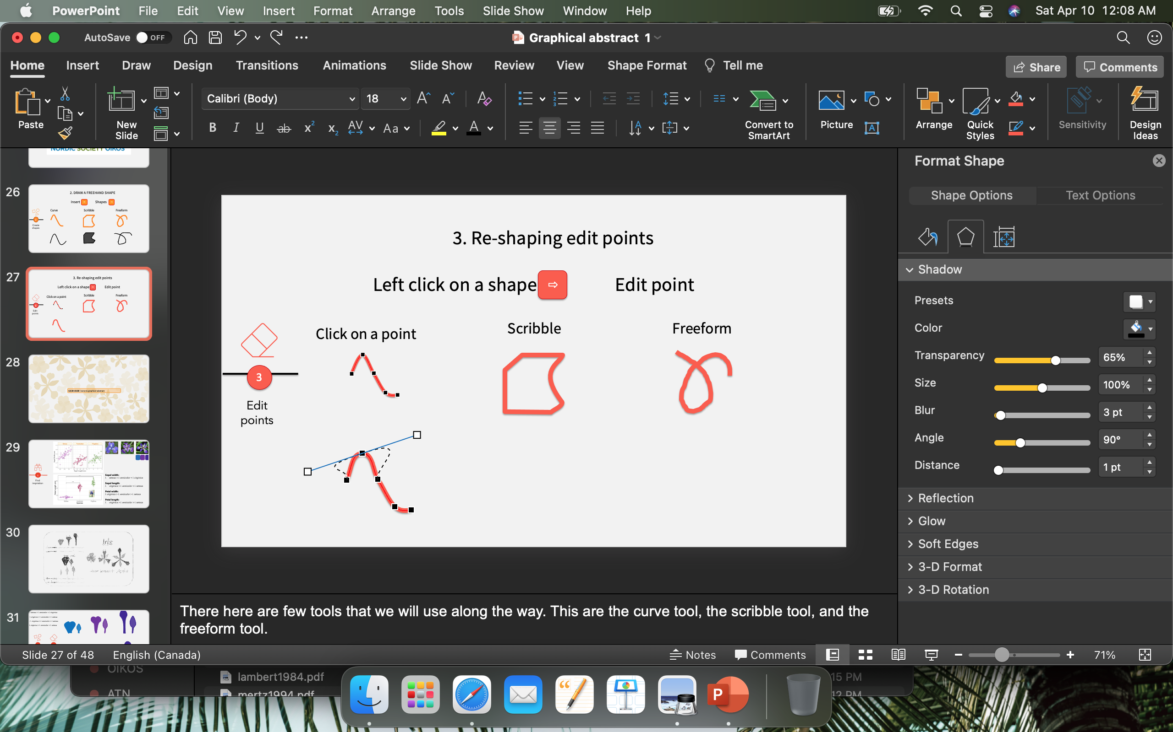
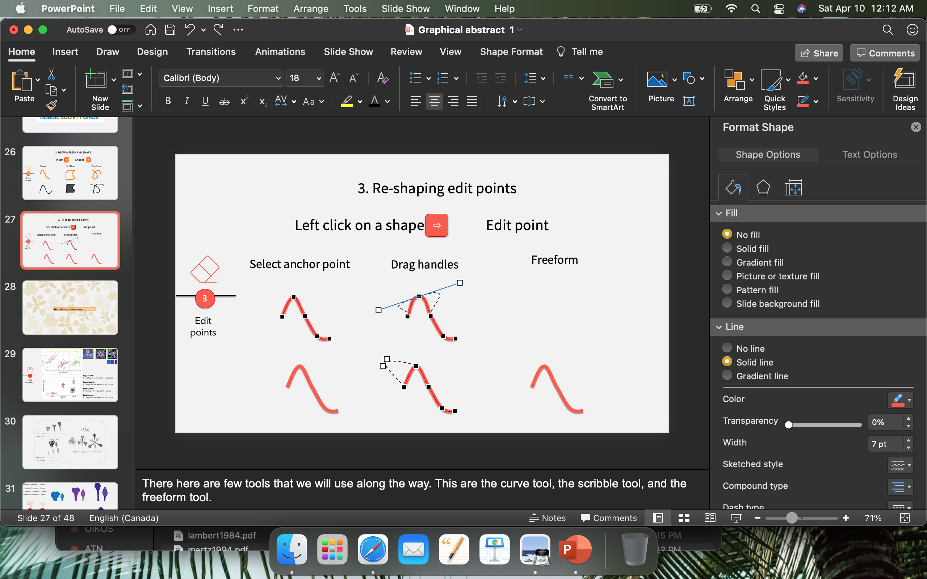

3. RE-SHAPING POINTS
Left click on a shape Edit point
⇧
Select anchor point
Drag handles
Add new point
3
Edit
points

Slide 13
4. MERGE SHAPES
Group/ Merge
Union
Combine
4
Assemble story

Slide 14
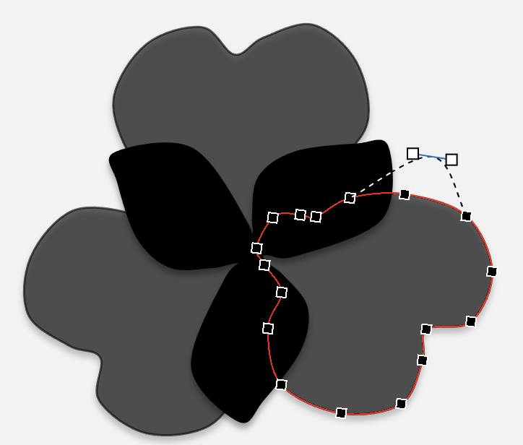
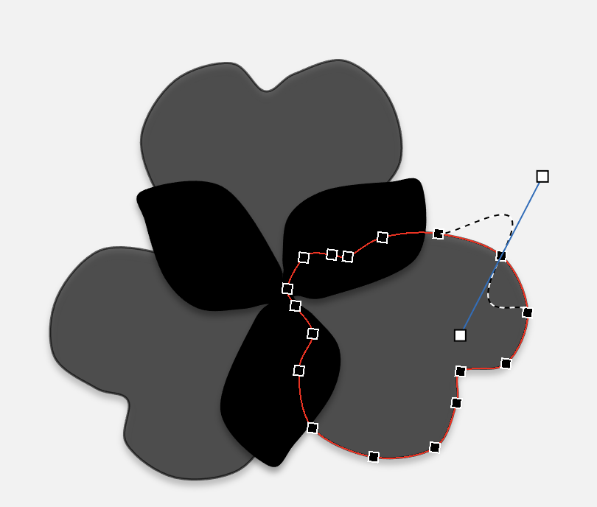
2. DRAW A FREEHAND SHAPE
Insert -> Shapes -> Curve
4. MERGE,
ARRANGE, ALIGN,
GROUP
1. UPLOAD YOUR SKETCH/IMAGE
1
2
3
4
Find
inspiration
Follow shapes
Edit
points
Assemble story
3. Select the shape -> Right-click -> Edit Points -> Select one anchor point ->
Drag the Point or Drag the Handles or Right click ->
Add Point
Delete Point
Open Path
Close Path
Smooth Point
Straight Point
Corner Point

Slide 15
1
2
3
4

Slide 16

1
2
3
4
Photo by Hans Jurgen Mager on Unsplash

Slide 17

1
2
3
4
Photo by Andries Meijer on Unsplash

Slide 18
1
2
3
4

Slide 19
SH

Slide 20
SH

Slide 21
Break-out room
SHARE YOUR STORY THROUGH
GRAPHICAL ABSTRACT

Slide 22


Realize your idea
There are lot of resources and tools
PowerPoint is cool too
Find your style
Share your science

Slide 23
@HocevarSara
https://www.sarahocevar.com
sara.hocevar@icloud.com

